Slide 1
COVID19 Patient Classification: Automated Feature Engineering and Hyperparameter Optimization
Presented by: M. Awais Tariq
R.No: 23I7606

Slide 2
Outline
Introduction
Domain Background
Literature Review
Problem Statement
Methodology
Dataset

Slide 3
Introduction
COVID-19, caused by a novel coronavirus, emerged in late 2019 and swiftly evolved into a global pandemic. Its rapid spread exposed weaknesses in healthcare systems worldwide, necessitating efficient management and resource allocation.
Objective: Investigate in detail the development of machine learning models with the intention of predicting COVID19 risk classification based on patient characteristics, conditions and medical history.

Slide 4
Domain Background
COVID-19 emerged in 2019, posing global health challenges. Traditional diagnostic methods have limitations, prompting the need for improved detection techniques.
The COVID19 domain highlights the critical importance of efficient resource allocation and patient management.
It helps health authorities anticipate risk allocation in patients with COVID19, prioritize resources, and use appropriate resources.

Slide 5
Problem Statement
The COVID-19 pandemic highlights the urgency of effective resource allocation and patient management. To address this, we aim to develop machine learning models capable of accurately predicting COVID-19 risk based on patient characteristics, conditions, and medical history. These models will assist in prioritizing resources and optimizing patient care in the face of limited healthcare resources and increasing patient numbers.

Slide 6
COVID19 Dataset Overview
Source: Mexican government
Contents: Anonymized patient data
Goal: Predict COVID19 risk
Features: 21 attributes
Patients: 1,048,576(rows)
Data Types: Boolean (1=yes, 2=no)
Classification: COVID19 test findings (13 for positive diagnosis, 4 or higher for negative or inconclusive).
Patient Type: Type of care received (1 for home, 2 for hospitalization).

Slide 7
Methodology
Data Collection
Preprocessing
Feature Engineering
Feature Selection
Modeling
Hyper-parameter Optimization
Evaluation
Model Selection

Slide 8
Contributions
Feature Engineering
  EntitySet Creation
    Used Featuretools library to create EntitySet 'covid19'
  DFS (Deep Feature Synthesis)
    Applied DFS to generate numerous new features by capturing complex relationships.
    Enriched dataset with engineered features derived from existing ones.

Slide 9
Contributions
Feature Selection Algorithm:
  Correlation Analysis: Identified and removed highly correlated features (>0.85) to enhance model learning.
  Variance Thresholding: Removed features with variance < 0.1 to eliminate lowvariance attributes.
  Feature Importance Selection: Utilized feature importance function of classifiers (GBM, AdaBoost). Fitted ensemble classifier on important features.
  Recursive Feature Elimination (RFE): Selected features recursively based on their importance in model tuning.
  Normalization and Thresholding: Normalized all features between 0 and 1. Selected features above a certain threshold for model training.

Slide 10
Contributions
Hyperparameter Optimization with Optuna
  Objective Functions: Defined separate objective functions for GBM and AdaBoost classifiers.
  Optimization Process:
    GBM Optimization: Hyperparameters: 'n_estimators', 'learning_rate', 'max_depth', 'min_samples_split', 'min_samples_leaf', 'subsample'.
    AdaBoost Optimization: Hyperparameters: 'n_estimators', 'learning_rate'.
    Study Direction: Maximize accuracy.
  Optimization Execution:
    Created Optuna study objects for GBM and AdaBoost optimization.
    Executed optimization process with a specified number of trials (n_trials=5).

Slide 11
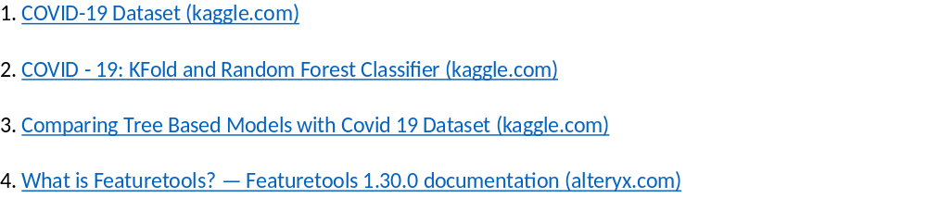
References:

Slide 12
Thank You

